Slide 1
Dungeons and Dragons Spell List
CS4613: Mobile Application
Final Presentation
Jeffrey Ratton
Joseph Hays
Daniel Woodard
Date: 5/7/2020
Notes:
Each person can introduce themselves at this slide.

Slide 2
Introduction of the App
The app allows easy access to commonly needed information about spells while playing a game of Dungeons and Dragons.
There are nearly 400 spells in the baseline Dungeons and Dragons.
This app’s goal was to put all of the spells and the needed information about those spells in the palm of one’s hand at ready and quick access.
We also made a favorite button and list to allow the user to access on the fly certain spells on a much smaller scale.
Notes:
Explain the project and its purpose.

Slide 3
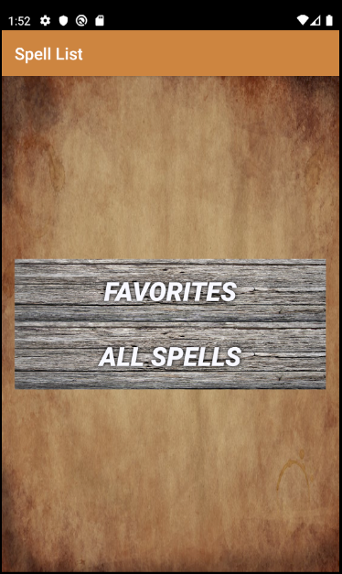
Home Page and Design
Our goal was to make a dated look for our application. Most settings for Dungeons and Dragons action roleplays take place in an older time period.
In order to do this, we found an older parchment-like color backdrop for the total app and old hard wood button textures for the buttons.
This button color forced us to change the text to a bold outlined white for clear reading, which in the end, looked better then we had hoped.
We darkened the border and tried to keep the title of the app within a similar color scheme.
Notes:
Explain purpose of choice of design

Slide 4
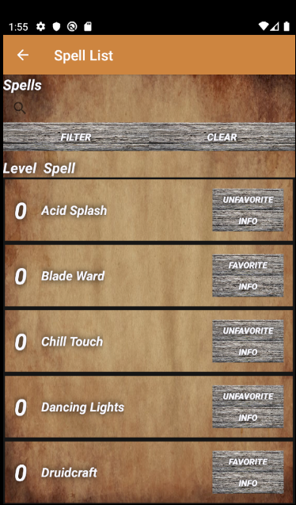
All Spells – Filter/ Clear
When it comes to viewing all of the spells, it was clear that their had to be some sort of filtering option.
There are close to 400 spells in non-modified D&D.
Thus, we created both a filter and a clear button to allow a user to jump around the list if they know any part of the spell.
Both the Filter and clear button change the information pulled and viewed by the recycler view (Recycler view will be covered a bit later).
This is accomplished using different user search inputs as SQL statements to grab smaller and more limited data.
The filter button can be used when any amount of text is input into the search bar.
The clear button clears the given filter out and returns it back into a state were all spells can be seen.
Notes:
Explain filter and clear and why we have them

Slide 5
All Spells – The database
DB browser for SQLite.
Is the database handler
The database itself was made as an external component and then transferred into Android Studio.
We wanted to use our past knowledge in SQL to make a stable database that we could modify on the fly, without the fear of something breaking within Android Studio.
Implementation of the database was simple; however, getting it to function within Android Studio was a timely setback.
Notes:
Explain the database that is holding the data

Slide 6
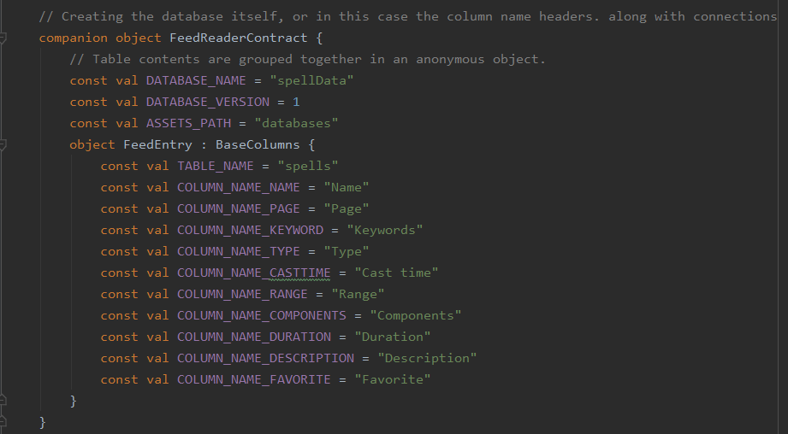
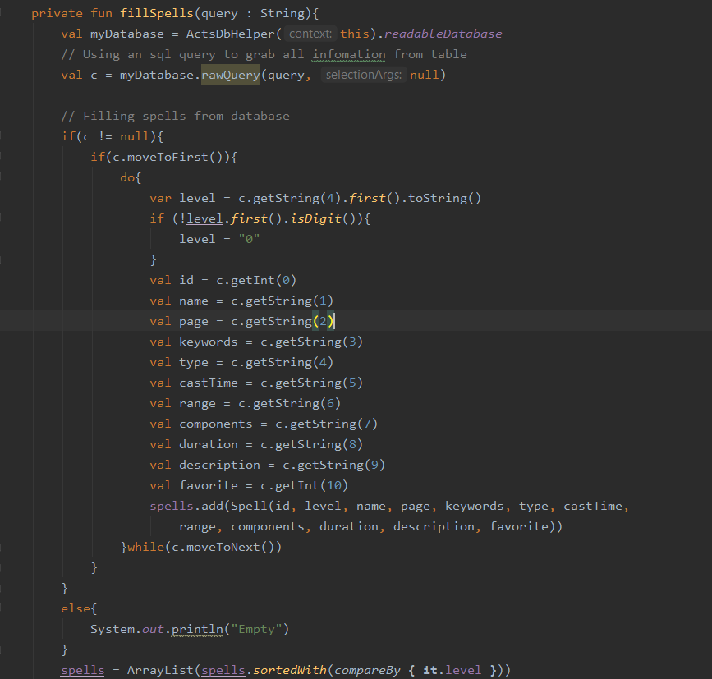
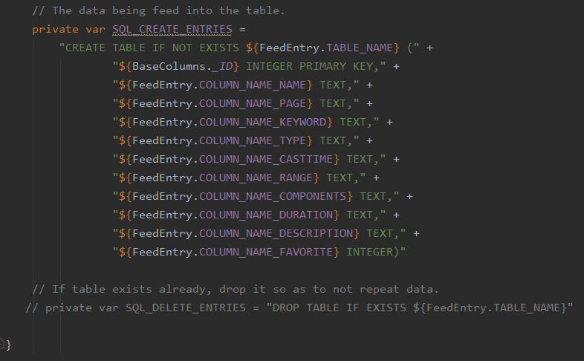
The database
This is showing tidbits of the importing and reading of the database.
For example, on the right you can see the function that fills a spell class object based on the given query through the parameter.
We use a cursor to move throughout the data.
Notes:
Explain the database that is holding the data

Slide 7
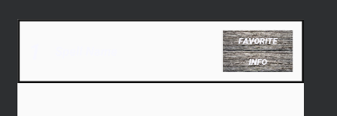
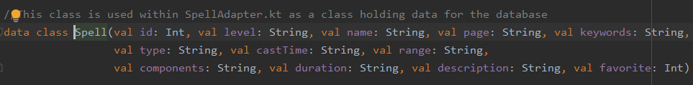
Recycler View
An item in the Recycler View
After reviewing the many options possible to display our data to the user, we decided to use recycler view.
Recycler view allows you to build one item (Spell) at a time and as needed.
Using the size of the database, we were able to create as many spells as needed to fill the recycler view with.
Whenever a user filters, the size of the recycler view will be changed and the number of Spells needed are changed.
Here you can see a class holding all of the information for a spell. The class would have objects created and filled as needed.
Notes:
Explain purpose of using the recycler view

Slide 8
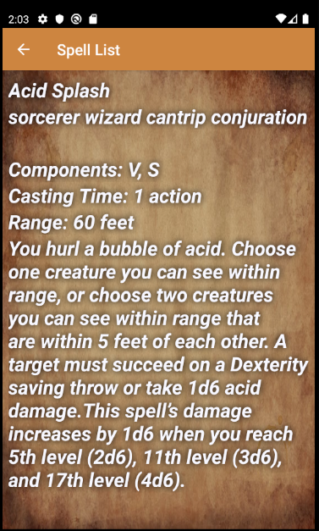
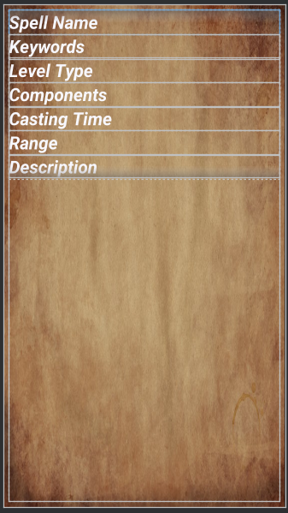
Info/Description Page
What the user would see
This is the XML page
We went for a simple design for the displaying of the information.
Each spell will be displayed in the same order and spacing to a certain degree.
We tried to display all relevant information a player might want to know on the fly.
Note: whatever the last page was determines where the back button sends the user. We tried to make it so that the user would not be teleported around the interfaces.
Notes:
Explain info page

Slide 9
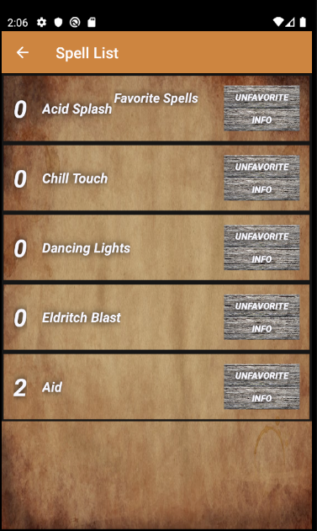
Favorite Page/Button
This allows a user to build a list of spells of the current character they have or preselect spells that they would want to use. It allows for fast access to a much smaller list of spells.
This was done by adding an additional column to the database, allowing the internal database to be able to keep up with which spells are favorited by use of simple SQL statements.
This information is saved between saved states.
Notes:
Explain purpose of choice of design

Slide 10
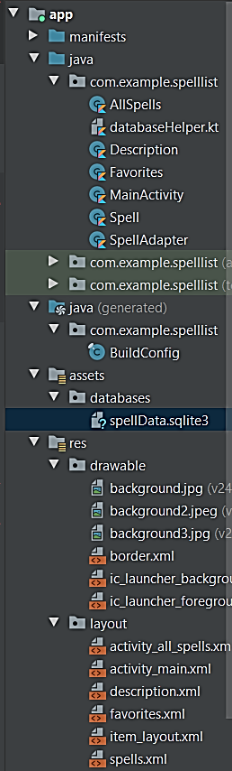
Conclusion
In the end, we managed to come to a happy conclusion of the baseline of what we originally thought the application should be able to do.
Show all spells, Sort through the spells, be able to create a favorite list.
Sadly, many of the features that were originally planned were never finalized.
Setting up certain code parts for the database and using the database took more time then we originally thought to learn and use.
The shift to online also impacted the ability to meet and work efficiently together.
Notes:
Explain the setbacks

Slide 11

Notes:
That’s all folks.

